Slide 1


Network protocols & security
24EC2210
Topic:
Transposition Techniques
Session – 36

Slide 2
Transposition Ciphers

Slide 3
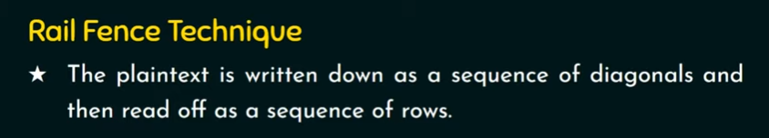
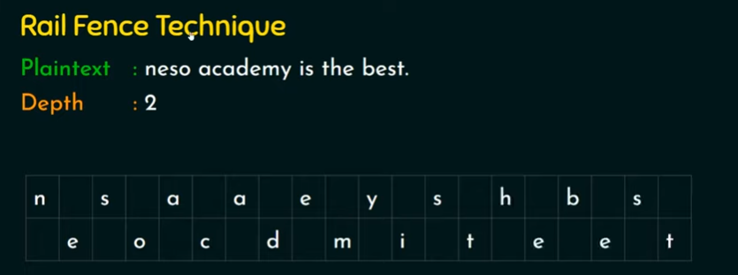
Rail Fence Technique

Slide 4
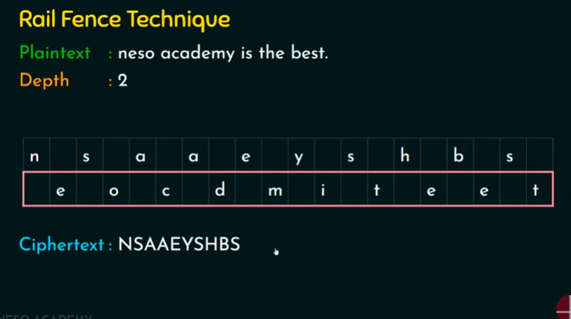

Slide 5
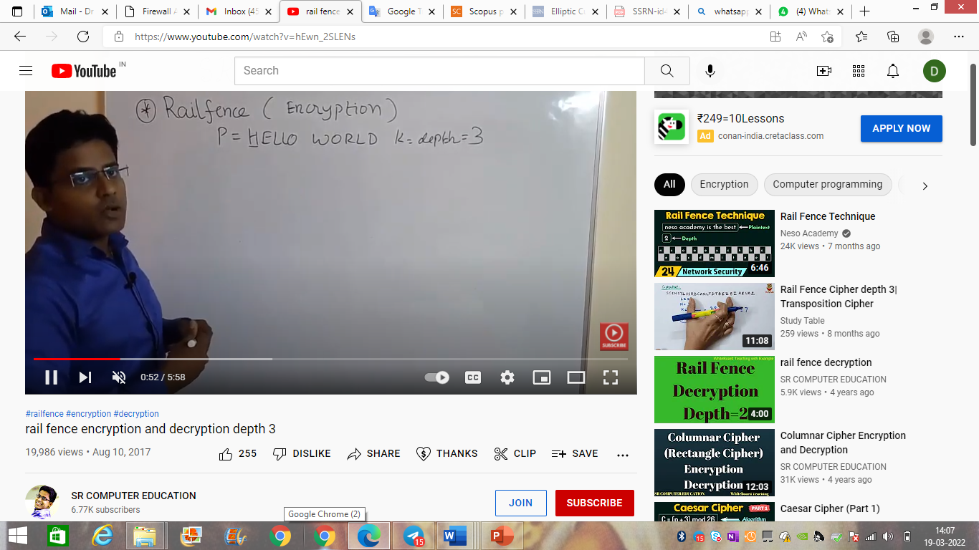
Rail Fence Technique

Slide 6
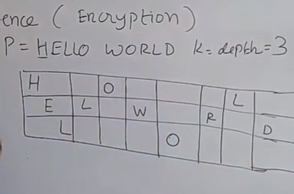
Rail Fence Technique

Slide 7
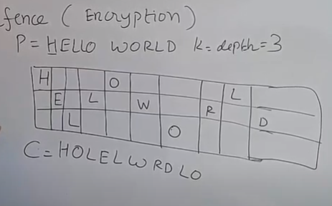
RailFence Technique

Slide 8
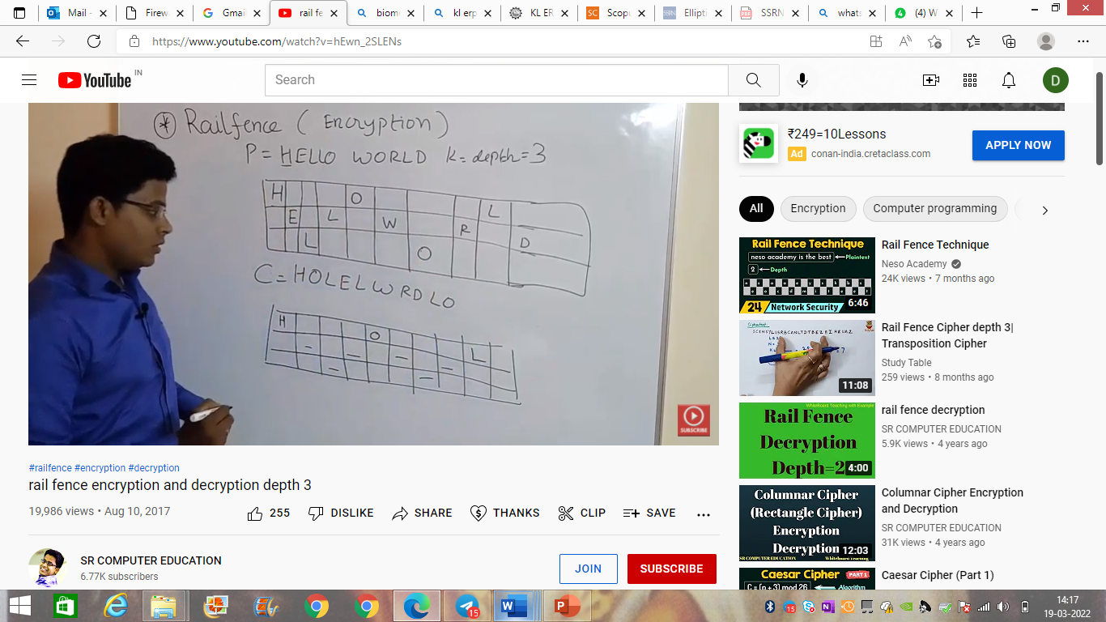
RailFence Technique

Slide 9
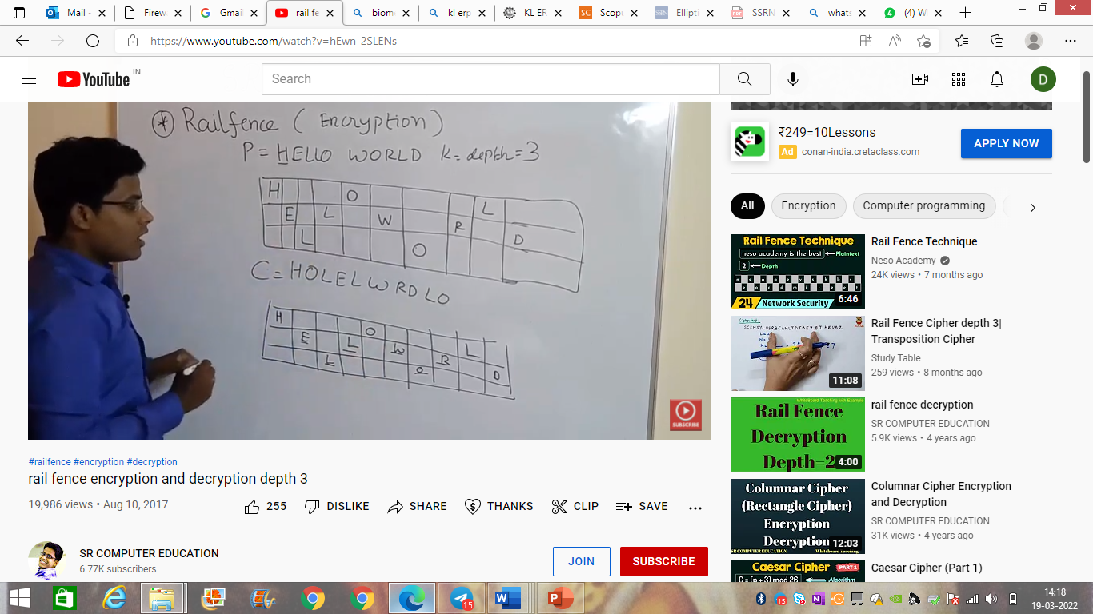
RailFence Technique

Slide 10


Rail fence Cipher
Plaintext: "defendtheeastwall“
Rails / Key: 2
Ciphertext: DFNTEATALEEDHESWL
_______________________________________________________
Key: 3
Ciphertext: DNETLEEDHESWLXFTAAX

Slide 11
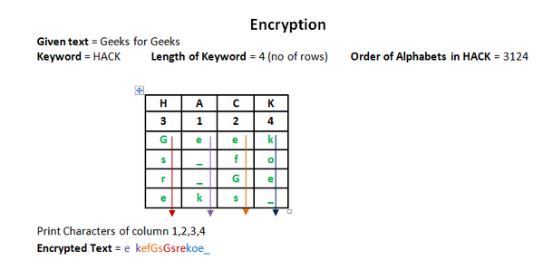
Columnar Encryption Technique

Slide 12
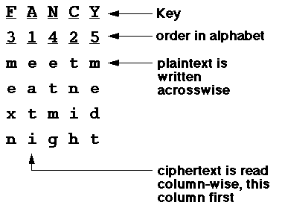
Columnar Cipher
Message: meetmeatnextmidnight
Key: FANCY
Ciphertext: eatitnihmexnetmgmedt

Slide 13
Ciphertext: DNETLEEDHESWLXFTAAX
Key : 3

